Slide 1
Pattern Recognition
Project 3
Clustering, dimensionality reduction and non-monotonous neurons

Slide 2
Task 3.1:
Fun with k-means clustering

Slide 3
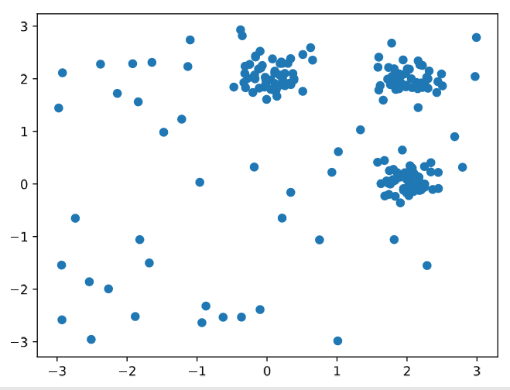
Scatter Plot of Data:

Slide 4
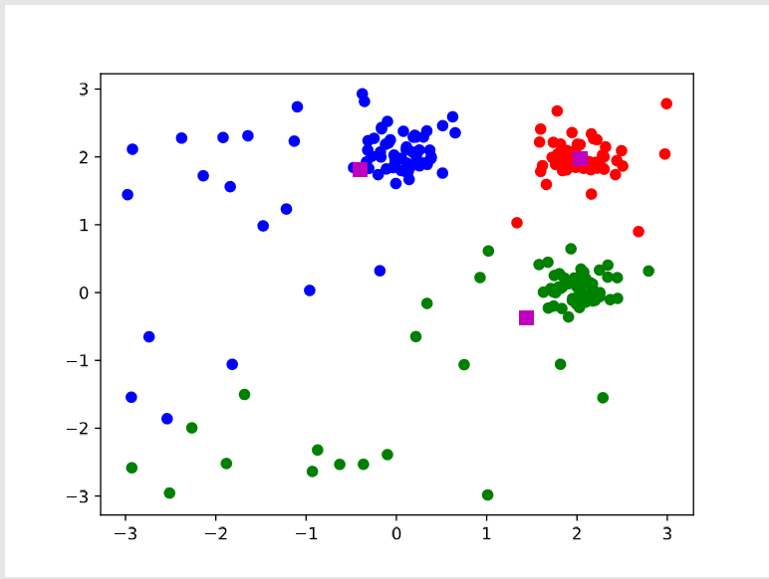


Lloyd’s algorithm :
Steps:
set t = 0 and initialize µt 1,µt 2,...,µt k repeat
until convergence
update all clusters
up
update all cluster means
Average Run Time: 0.203 s

Slide 5
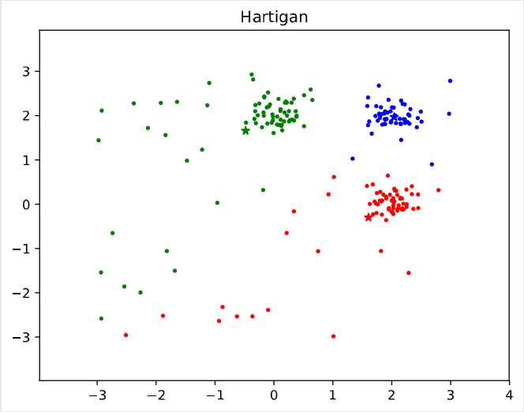
Hartigan’s algorithm :
Steps:
for all xj ∈x1,...,xn,
randomly assign xj to a cluster Ci for all Ci ∈C1,...,Ck
compute µi repeat until converged
determine Ci = C(xj) remove xj from Ci and recompute µi
determine Cw = argminCl EC1,...,Cl ∪{xj},...,Ck
if Cw != Ci, then converged ←False assign xj to Cw
recompute µw
Average Time Taken:0.418s

Slide 6
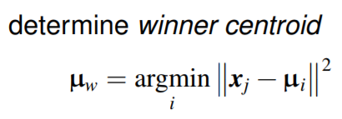
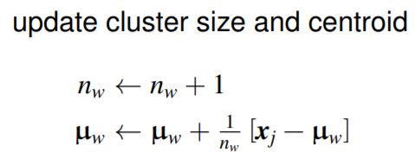
McQueen’s algorithm :

Slide 7
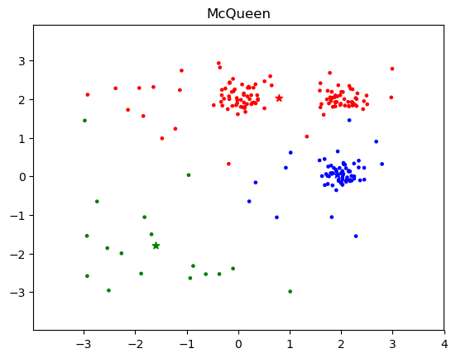
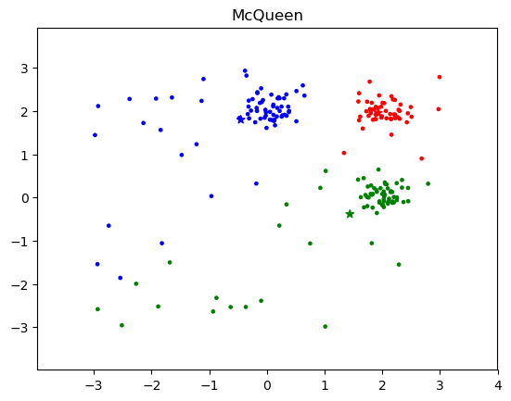
McQueen’s algorithm :
Most common case
Rare case
Average Time Taken: 0.63µs

Slide 8
Task 3.2:
Spectral Clustering

Slide 9
Spectral Clustering
Clustering method with roots in Graph Theory. The steps are as follows:
Convert set of points X to a matrix S, simulating an adjacency matrix by using a similarity measure.
Calculate a (diagonal) degree matrix D by summing up similarities for each node.
Calculate Normalized Graph Laplacian Matrix L = D - S and calculate the eigen values and vectors of L.
Calculate the Fiedler Vector which is the one with the second smallest eigen value and use it for clustering.
FV gives the approximation of the minimum graph cut needed to separate the “graph” into 2 CCs.

Slide 10
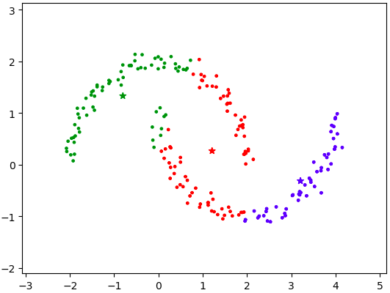
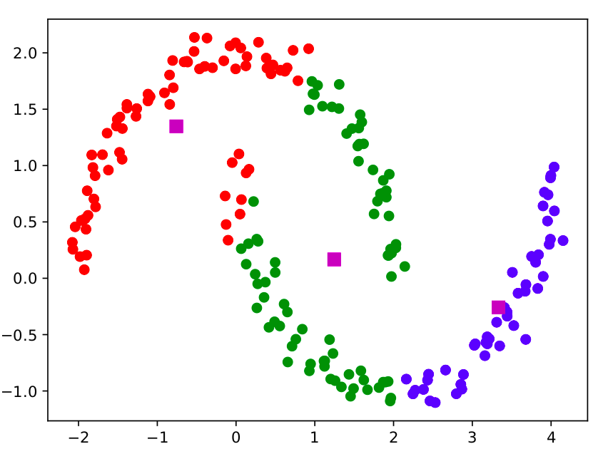
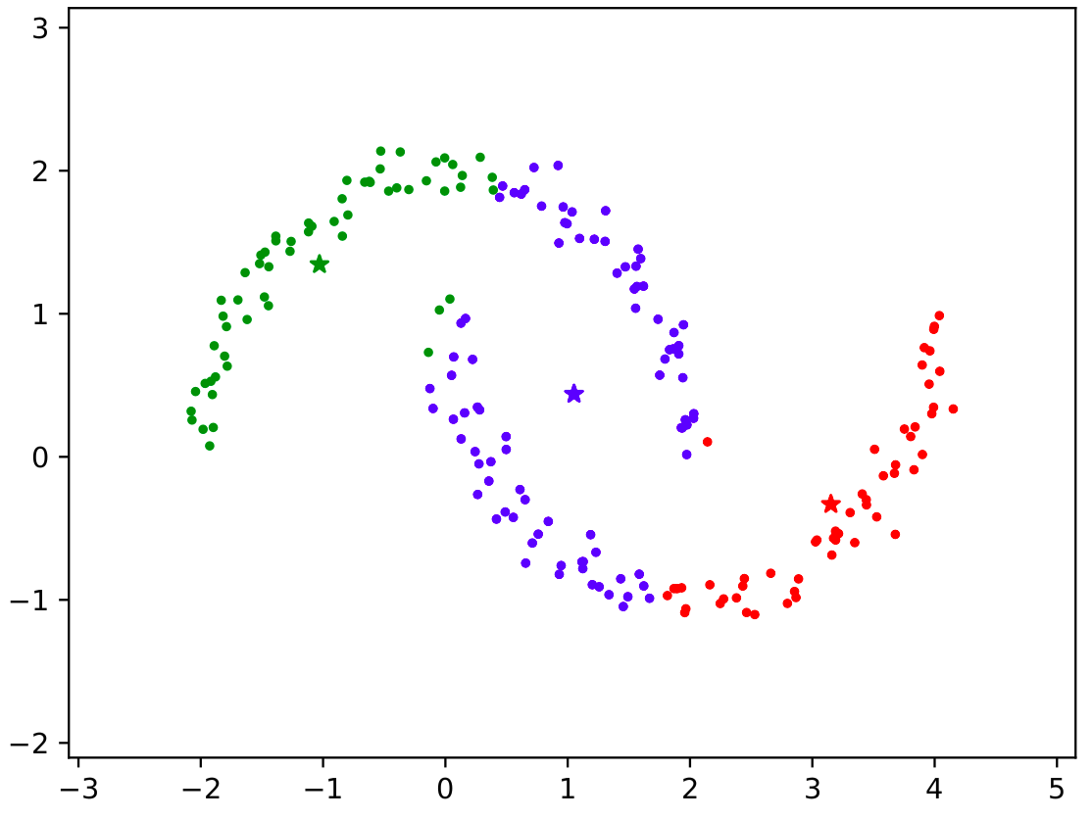
Failure of K-Means
McQueen’s, Lloyd and Hartigan’s K-Means Clustering Algorithms

Slide 11
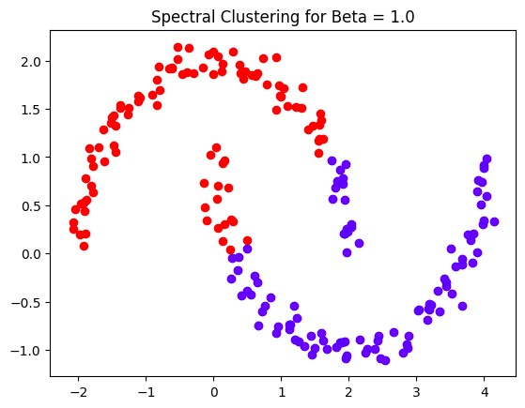
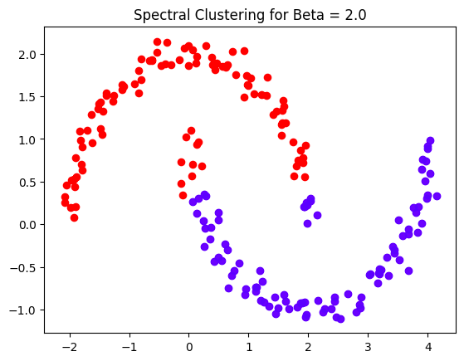
Spectral Clustering

Slide 12
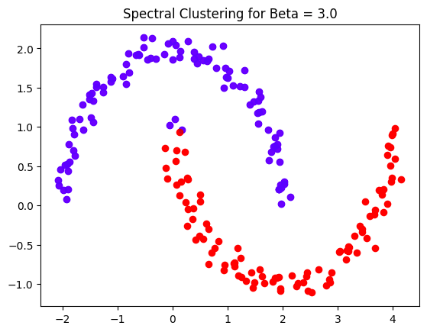
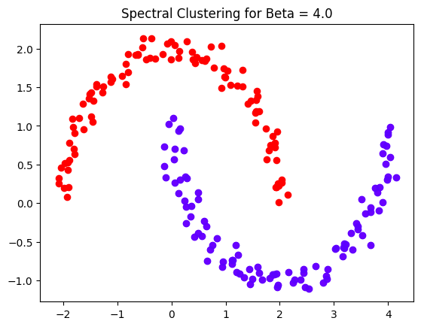
Spectral Clustering

Slide 13
Task 3.3:
Dimension Reduction

Slide 14
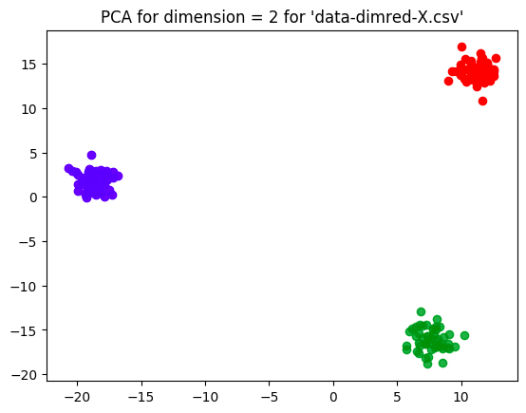
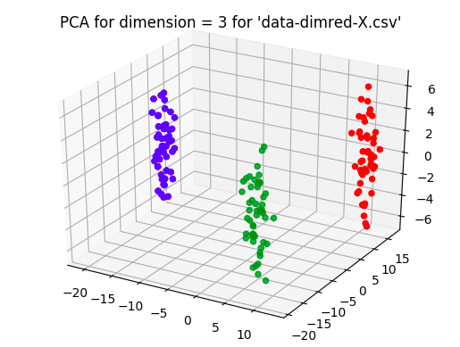
Principal Components Analysis (PCA)
PCA: Projection using the top eigenvectors of C

Slide 15
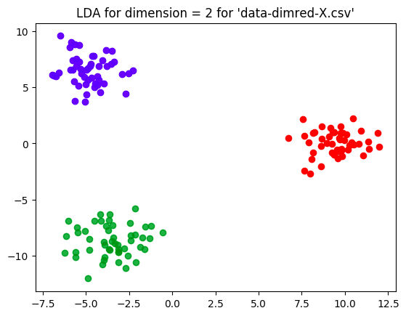
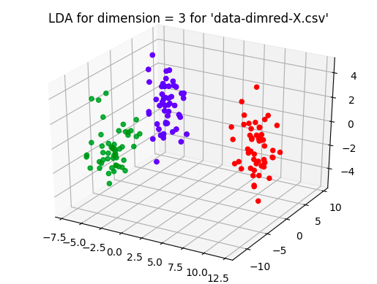
Linear Discriminant Analysis (LDA)
LDA: Projection using the top eigenvectors of S_{W}⁻¹S_{B}

Slide 16
Task 3.4:
Non-monotonous neurons

Slide 17
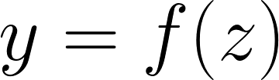
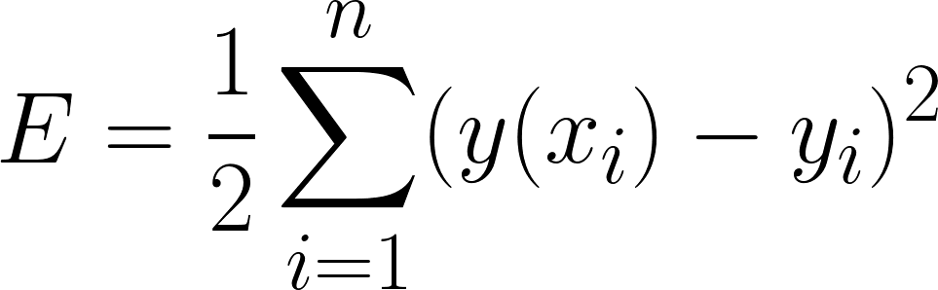
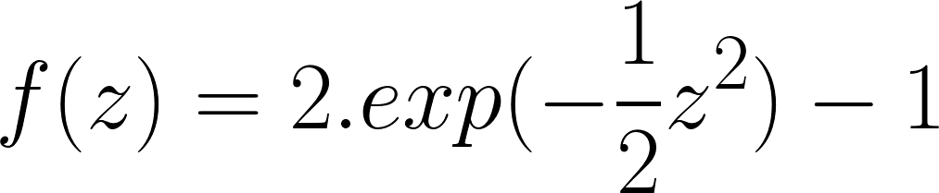
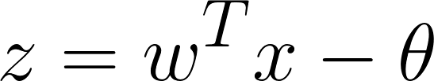
Problem Statement:
Train a non-monotonous neuron on a XOR problem, with an activation function f and loss function E using Gradient Descend:

Slide 18
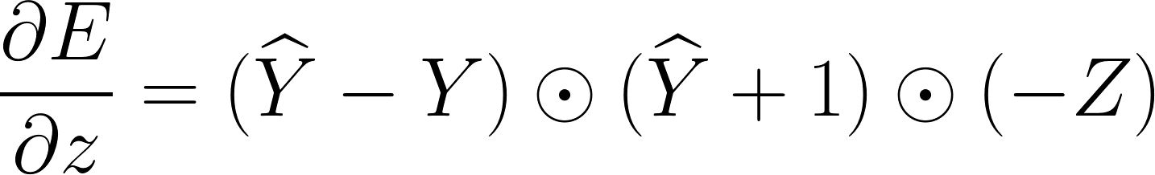
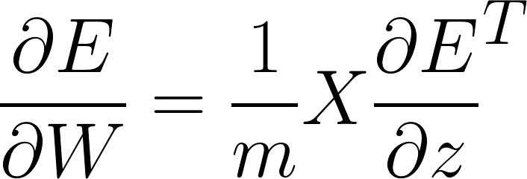
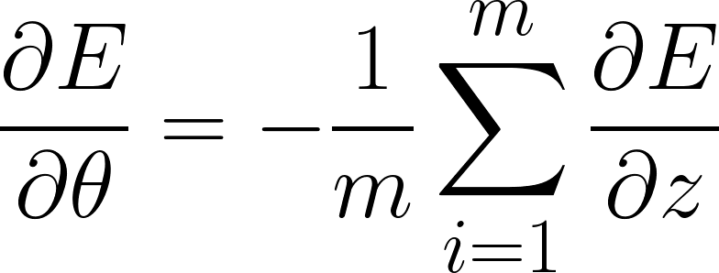
Equations for Computing Gradients

Slide 19
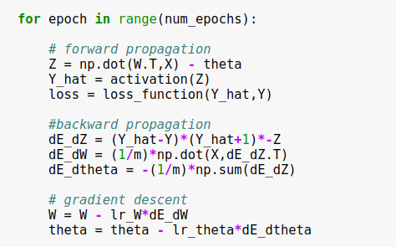
Numpy Implementation

Slide 20


Hyper parameter Tuning
Learning rate for the parameters were searched in a random grid on a logarithmic scale.
was tuned in the range (0.005,0.5)
For , exploration was done in the range (0.001,0.1)

Slide 21
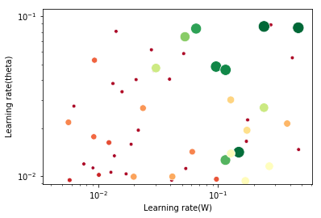
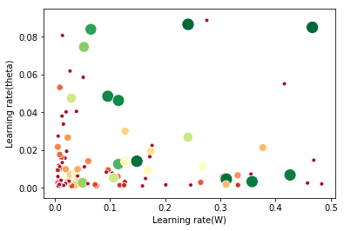
Hyper parameter Tuning
On Logarithmic Scale
On Linear Scale

Slide 22
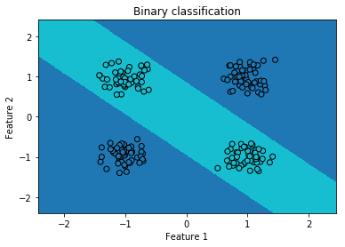
Results

Slide 23
Task 3.5:
Exploring Numerical Instabilities

Slide 24
Problem Statement:
To revisit the Least Squares regressions for prediction at higher dimensions.

Slide 25
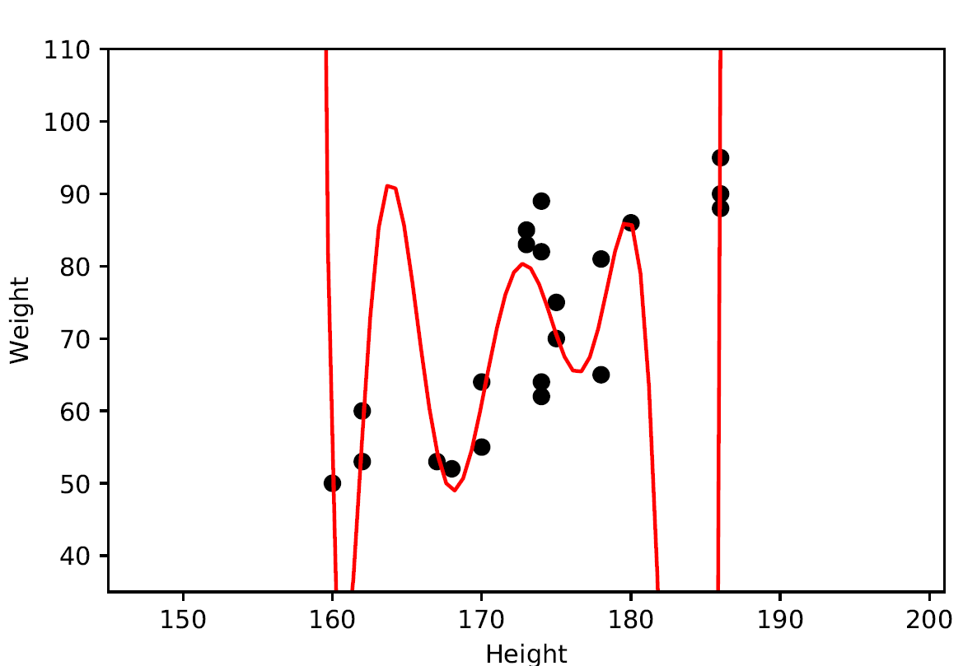
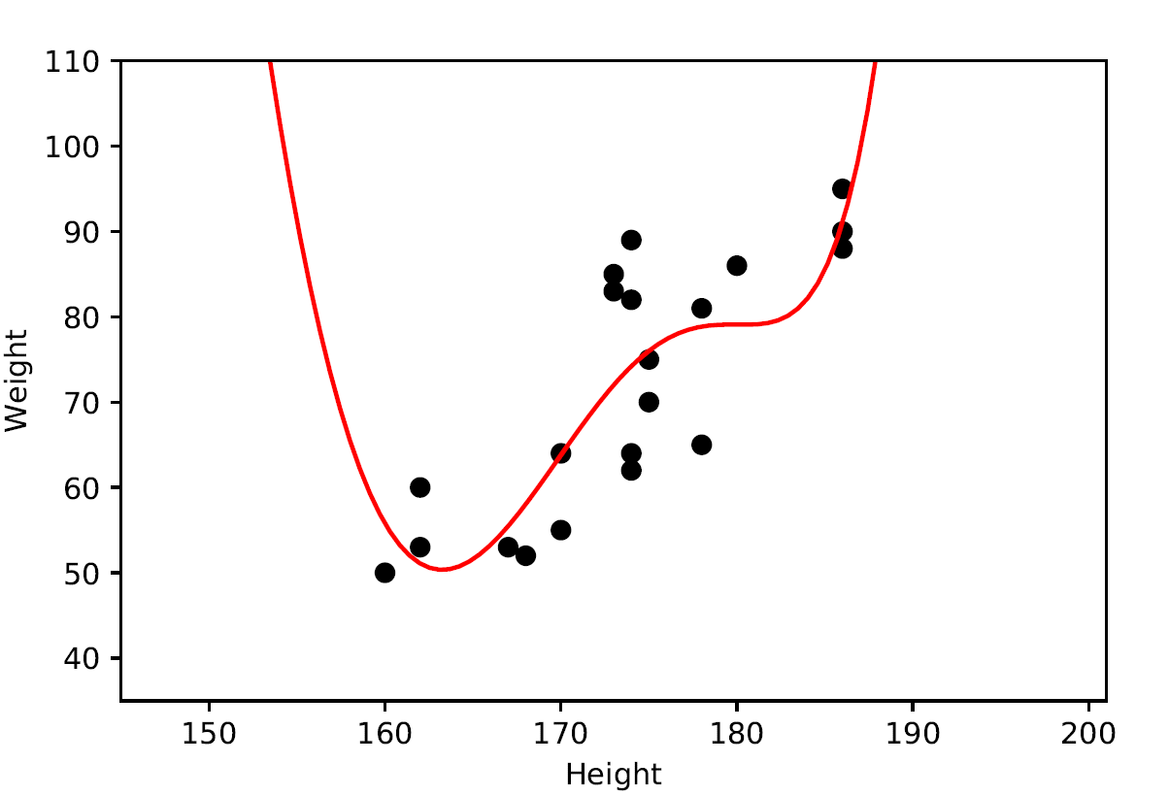
Method: Polyfit
Method: Vandermonde matrix and pinv
Warning:RankWarning: The fit may be poorly conditioned c = poly.polyfit(hgt, wgt, 10)
Standard fitting using inverse of the vandermonde matrix
Improper fit.
Fit using inbuilt Polyfit.
This implies that the best fit might not be well-defined due to numerical errors. The results may be improved by lowering the polynomial degree or by transforming the data.

Slide 26
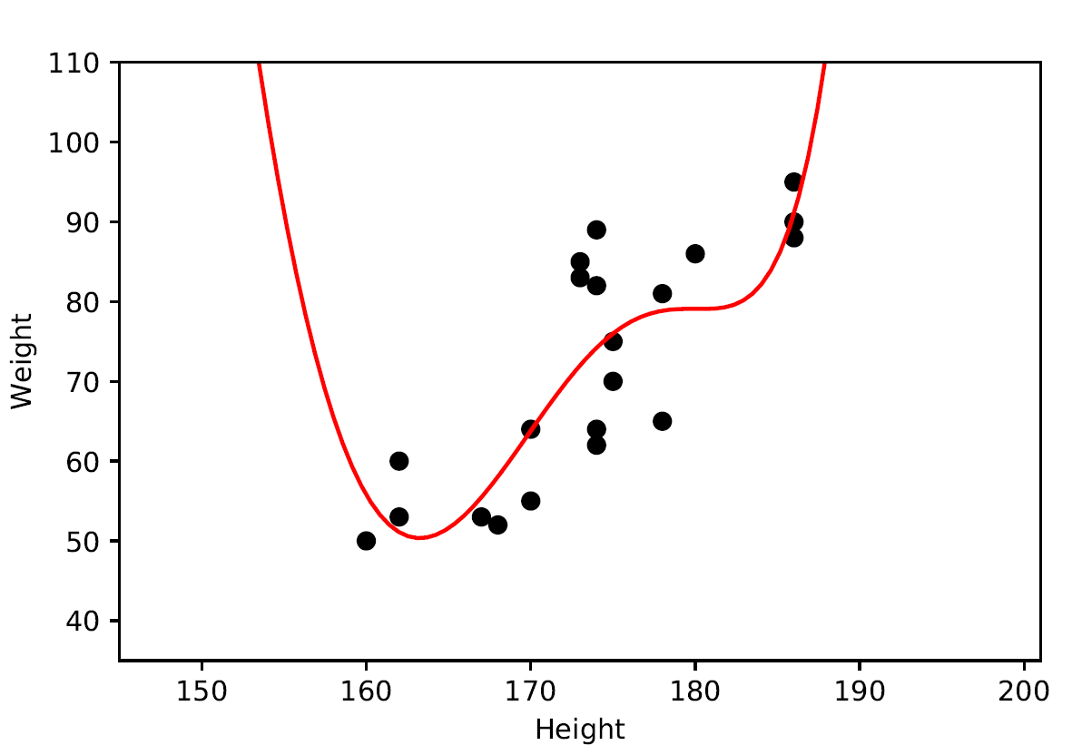
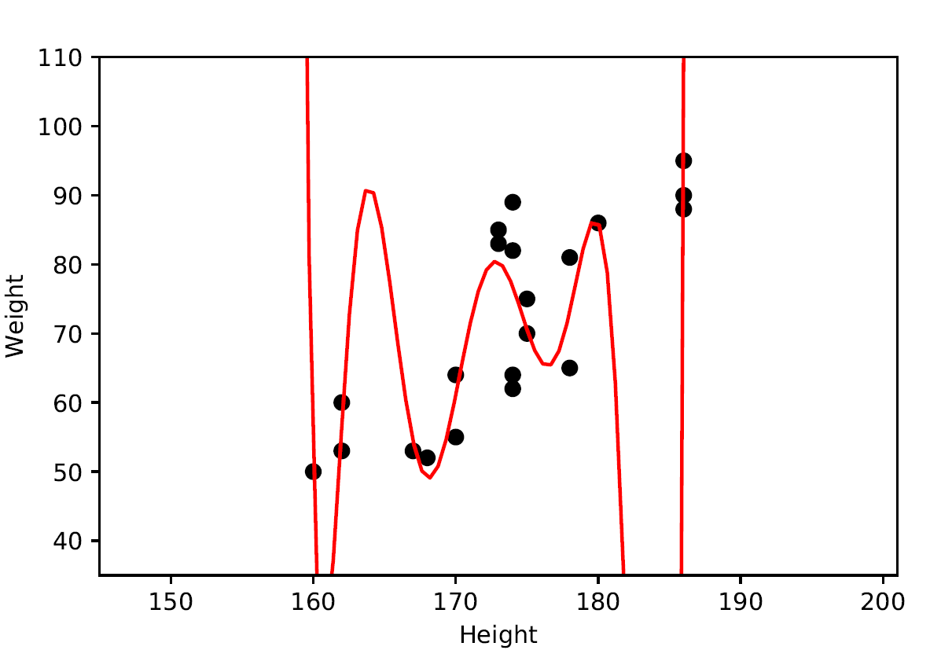
Method: Vandermonde matrix and lstsq
Method: transformed Vandermonde - pinv
Standard fitting on Vandermonde Matrix using least squares
Improper fit.
Fitting on Transformed Vandermonde Matrix using pinv
pinv(X/100) gives the correct pinv(..) values while avoiding numerical errors

Slide 27
Thank You.

